Slide 1
Enhancing Breastfeeding and infant and young child feeding practices practices in Himachal Pradesh
Dr Arun Gupta
Breastfeeding Promotion Network of India(BPNI) @ Ministry of WCD Govt. of HP Simla
September 4, 2015

Slide 2
Overview
Why its important
What is the Status of NMR,IMR, optimal infant and young child feeding practices
How to enhance optimal practices and What national programmes demand
How we plan to work with Govt. of HP
About BPNI
Video of Lalitpur Success

Slide 3
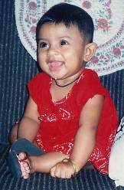
First year is critical!
Malnutrition strikes the most in infancy beginning in 3-4th
month, 29-30 % at 6 months, goes up and peaks about 46%
by 18 months, flat curve after that (NFHS 3).
Brain development
1
2
3
4
5
7.7 lakh children
die during
first month,
11 lakhs by
1 year, and 14 lakhs
by 5 yrs. 2/3rd are related to poor feeding.
Underweight (-2sd) NFHS-3
Over 60 million
Years of life
Notes:
3
3
In this slide you will see how first year is so critical – as among first 5 years of life shown as bars. The underweight bar is what begins in 3rd month of life and reaches about 29-30% by six months according to NFHS-3. After this it peaks by 18 months and then it almost flat – meaning thereby that action to ‘prevent under-nutrition’ should be a priority. Look at the brown line zooming through first – five years. This is for brain development and 70% brain develops during first year, 90% by end of 2 years .Finally, see out of approximately 20 Lac children who die annually( in India) around 14 lac die during first year of life. And rest later in four years. All this makes “first year” so critical.

Slide 4
Child Mortality in Himachal Pradesh

Slide 5
Status of Malnutrition in Himachal Pradesh

Slide 6
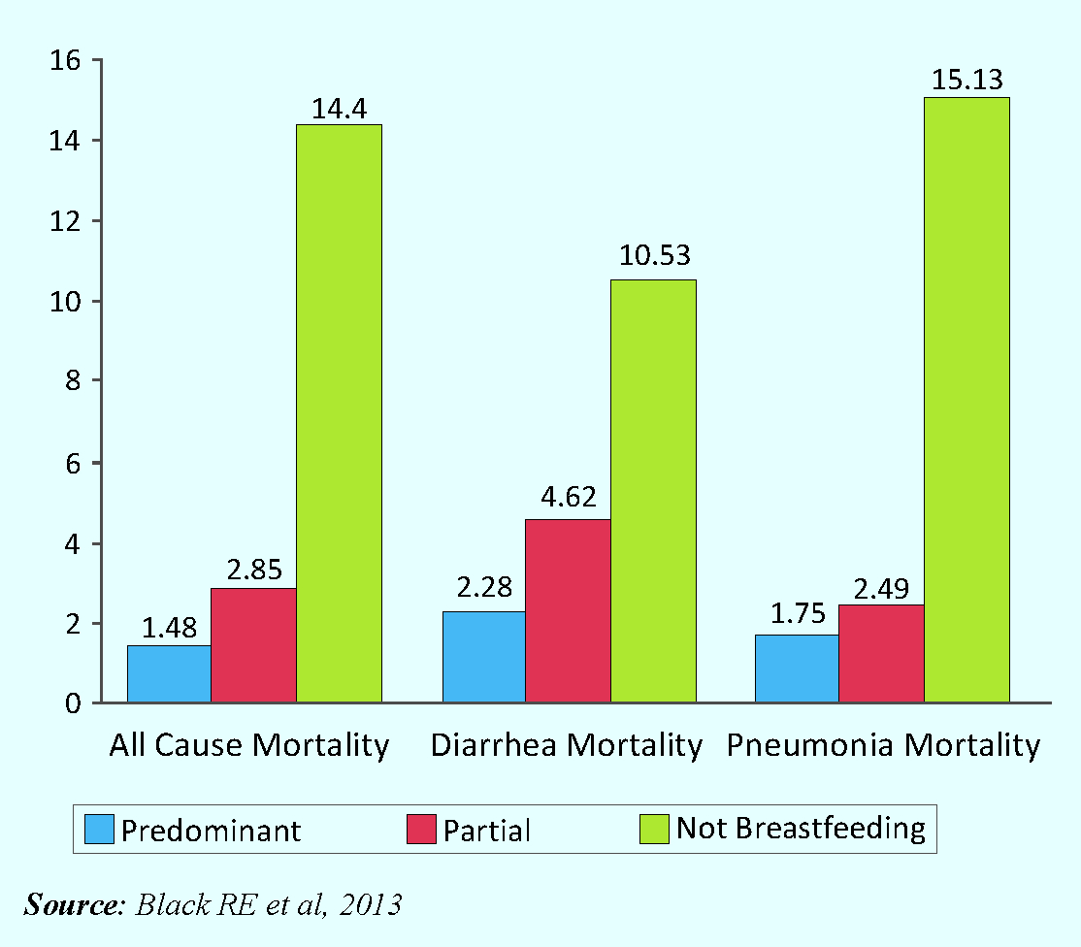
Breastfeeding Saves Lives!
Source: Black RE et al, 2013
Notes:
During the last decade or so a plethora of research evidence has come up showing how breastfeeding is crucial to prevent child deaths undernutrition and Non-communicable diseases later on in life. Let us see the evidence one by one.
Graph on the left says, the risk of death as a result of infection increases 2.6 times if breastfeeding is initiated after Day 1 in comparison to initiating with in one hour of birth.
Graph on the right says, the Relative Risk of mortality from diarrhoea and pneumonia and all cause mortality in the first six months of life increases many fold due to suboptimal breastfeeding. The risk is highest in case of no breastfeeding but predominant and partial breastfeeding also increases chances of deaths due to pneumonia and diarrohea.

Slide 7
Risk of neonatal mortality according to time of initiation of breastfeeding
Six times more risk of death
Source: Edmonds EK et al, 2007 - Pediatrics 2006;117:380-386
Notes:
In addition to the survival value of breastfeeding in addition to shown by the Lancet series in 2003, new evidence from Ghana study points out that if ALL mothers begin breastfeeding within one hour 22% of newborn deaths can be cut. Mortality of newborn babies increases 6 times, if it is delayed to 72 hours. Lets see what it means in numbers in the next slide…

Slide 8
IYCF Practices in Himachal Pradesh
(DLHS 3 2007-08)

Slide 9
Exclusive breastfeeding drops sharply!

Slide 10
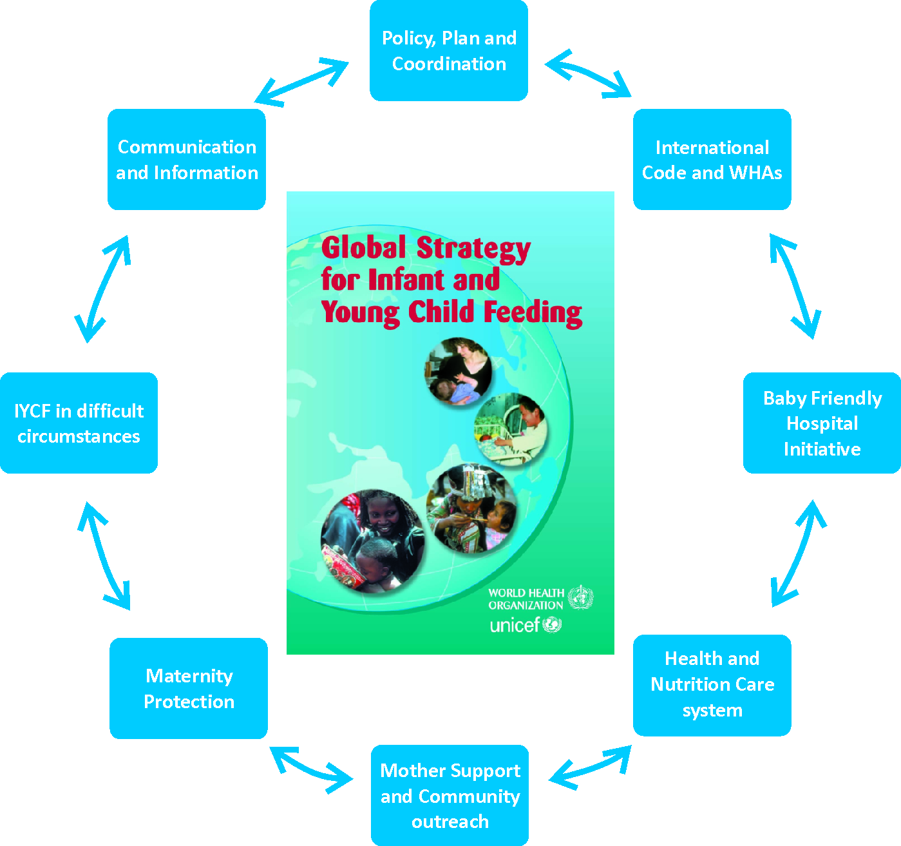
What Action is required to improve IYCF Pratices?
Policy, Plan and Coordination
Maternity Protection
International Code, WHA
Health, Nutrition care System
Mother support, community outreach
BFHI
IYCF in difficult circumstances
Communication and Information
Training
Protection
Promotion
Support
Notes:
Improving IYCF practices requires comprehensive interventions to build a conducive environment for the women to breastfeed. GSIYCF has outlines all the subject areas for protecting, promoting and supporting breastfeeding. (Read color coded intervention areas). This is important to note that for creating a conducive environment, Multi-sectoral action is required and implementation of a few interventions in isolation will not be sufficient.

Slide 11
What is required to Enhance Optimal IYCF Practices
Protection: By ensuring implementation of the IMS Act 1992, and Amendment Act 2003
Promotion: By providing accurate information and skilled counselling to all women, family and community members in the instituion and community.
Support: By providing support measures for sustained appropriate feeding through maternity protection.

Slide 12

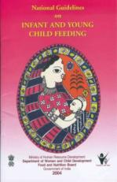
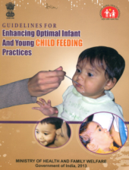
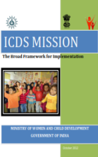
What is Optimal Infant and Young Child Feeding Practice
Begin breastfeeding within an hour
Exclusive breastfeeding for the first six months
Complementary feeding after six months
Continued breastfeeding for 2 years or beyond

Slide 13

ICDS Mission document has emphasised role of Counselling
Strengthening ECCE
Focus on under-3s
Care and Nutrition Counselling service for mothers of under-3s
Institutions / voluntary organisations with expertise on IYCF practices, like Breastfeeding Promotion Network of India (BPNI) would be engaged.

Slide 14
Evidence that Breastfeeding Counseling works!
Method of Counseling | Increase in Odds of EBF
 | Neonatal Period | At Six Months
Individual counseling 15 studies | 3.45 (95%CI 2.20-5.42) p<0.00001 | 1.93(95% CI1.18 – 3.15) p<0.00001
Group Counseling 6 studies | 3.88 (95% CI 2.09-7.22) p<0.0001 | 5.19 (95% CI 1.90-14.15) p<0.00001
Meta-analysis on breastfeeding promotion strategies and feeding patterns Haider BA, Bhutta ZA. Lancet 2008.

Slide 15
Peer Counselling by Mother Support Groups help: The Lalitpur Experience
IYCF Indicator | Baseline (Nov 2006) | Post – intervention (Dec 2011)
Initiation of BF within 1 hour | 11% | 62%
No use of Pre-lacteal feeds | 67% | 5%
Exclusive BF for 6 months | 7% | 60%
Initiation of complementary feeding (6–8 months) | 54% | 96%
Kushwaha KP et al. PLOS 2014

Slide 16
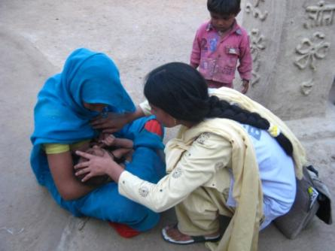
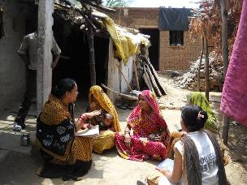
Counseling Works in Lalitpur
We will appreciate 10 minutes for a video on Lalitpur

Slide 17
100,000 babies are delivered per year (280 everyday) in HP -75% in institutions
Antenatal counselling
At birth counselling:
To initiate breastfeeding
Rooming in
Avoiding prelacteal feeds
Demand feeding
Later on:
Counselling to practice exclusive breastfeeding
Skilled support for breastfeeding problems
After 6 months: Counselling to practice appropriate complementary feeding

Slide 18
How we propose to work with Govt of HP WCD
Build capacity of AWW in skills for counselling on breastfeeding and infant and young child feeding practices

Slide 19


Course- Structure (Algorithm)
IY C F Counseling: A Training Course
The 4 in 1 course
Training of Middle Level Trainers 7 days
MLTs
Training of FLW 4 days
Family counsellors

Slide 20
Plans
Non of districts 12
Number of AWC ~ 18,000
Number of Training courses required = 600
Per district ~ 50
Propose 4 MLT courses with 96 trainers
This can finish the work in 15 month if they do one 4 -day training in a month for FLWs

Slide 21
What are our roles
MOWCD:
BPNI
Partner with BPNI and sanction budgets
Sign MOU
Appoint state coordinator, logistics etc.
Identify participants of MLT courses
Organize and plan 4 day training for the frontline workers
BPNI: Provide trainers for MLT courses
Training kits
Monitoring and evaluation
Supply training and IEC materials if required for FWs
Refresher if needed

Slide 22
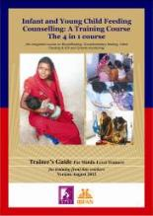
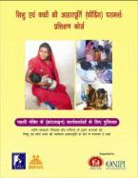


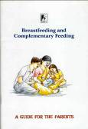

‘4 in 1’ training programme - Course Material
CD PowerPoint of AV aids
Training Aids for trainers of family counselors
Trainer's Guide to train IYCF counseling specialist or middle level trainer
Manual for family counselors
Breastfeeding and Complementary Feeding - Counseling Guide for Frontline Workers
Breastfeeding and Complementary Feeding - A Guide for Parents

Slide 23

Breastfeeding Promotion Network of India
BPNI – founded in 1991
Registered under SRA-1860 (S-23144)
More than 3600 members
Elected CCC to take decisions
Gazetted organisation to monitor IMS Act

Slide 24



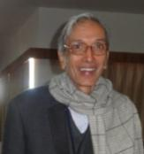










BPNI secretariat – technical and administrative team of 14 persons

Slide 25
BPNI - Major Areas of Work
Advocacy
Capacity Building
Monitoring of violations of the IMS Act
Research
Documentation – policy documents, position statements, news letters, reports etc.
Expert inputs in the nutrition and health policies and programmes

Slide 26
BPNI assists Government
Member, Prime Minister's council on India’s nutrition challenges
Member, the National Steering Committee on Infant and Young Child Feeding, MWCD, GOI
Member, 12th five year plan working group on nutrition
Member, TRG on Child Health, MOH
Member, NAG on Nutrition, MOH
Member, TRG on PPTCT
Member, infant feeding and HIV expert group of NACO
Member, CCNFSDU

Slide 27
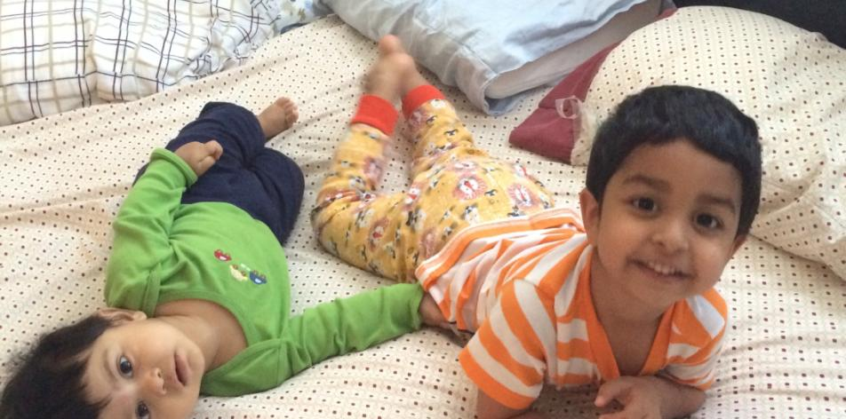
Thank you for listening !!

