Slide 1

Meeting of the Inter-ministerial Group on Draft Nutrition Strategy
29 Feb 2016
Niti Aayog, Government of India
Dr Arun Gupta

Slide 2
Why “Exclusive Breastfeeding” should be an indicator?

Slide 3
In India Annually,Breastfeeding can prevent…
Under-5 child deaths*
156,000
Prevents 1 in 3 new case of type -2 diabetes
Source: Lancet Series on Breastfeeding 2016
* UN IGME Report 2015 ** RSOC 2014
Notes:
If India increases its breastfeeding rates near universal, according to Lancet 2016,it could prevent 3,900,000 diarrhea episodes and 3,436,560 pneumonia episodes annually. At the same time it could reduce 156,000 under five child deaths. This is quite substantial reduction. Most of these deaths about 85% are under six months of age. Therefore, it is critical to invest in policy and programmes before and around those months and ensure rise in exclusive breastfeeding ..currently we are stagnant.

Slide 4
Building IQ and Economy
Building into IQ of the Nation
This is critical difference it can make
3 points across all income levels, in rich or poor
translates to improved
academic performance, increased long term earnings
Super power
Cutting edge
SDGs targets for
education, poverty and reducing inequalities.
Addition to the Economy
The Lancet reports that India can add 0.6285 Billion US$ which is approx. 4300 Crores annually, through improved IQ.
Notes:
This slide shows how much investing into breastfeeding can contribute to cognitive development and economy of the country. This is is clear that breastfeeding could lead to improved earning ability of people , India’s economic survey 2016 recognises breastfeeding to be high impact intervention to reduce neonatal and infant mortality as well.

Slide 5
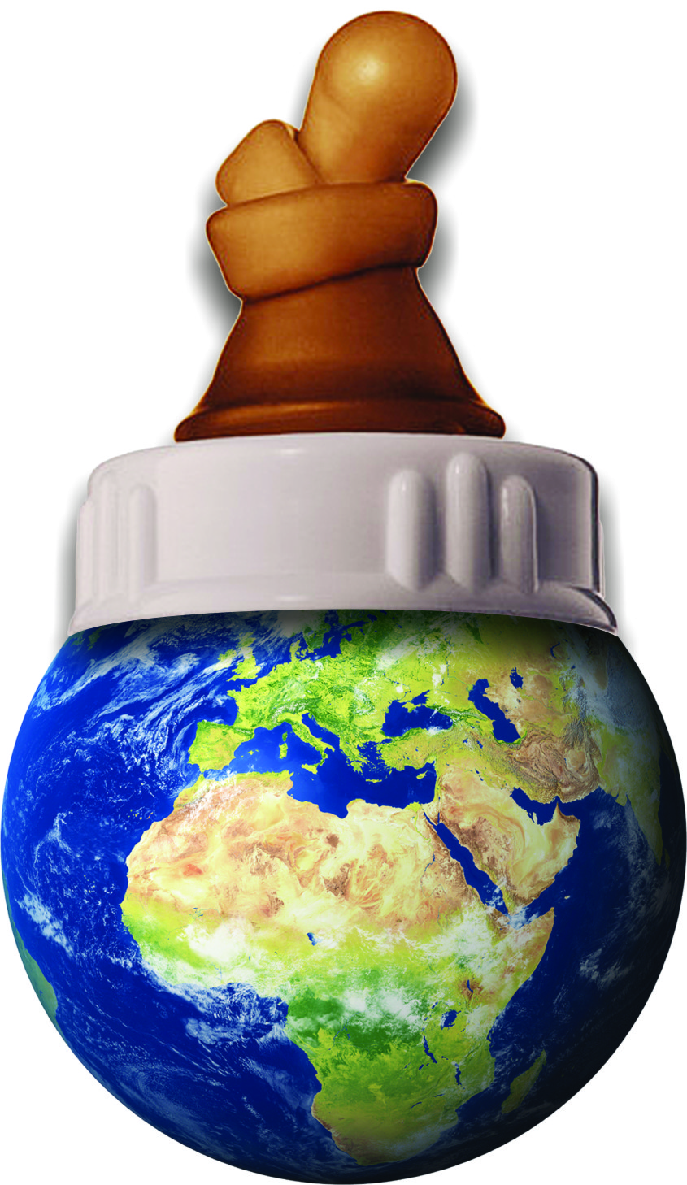
GHG Emission Attributable to Milk Formula (2012)
Source: BPNI Report
Euromonitor International (2013) Passport Baby Food in India Report
Euromonitor International (2012) Passport Baby Food in China Report
Notes:
It is to India’s credit that Indian law IMS Act has restricted sales of milk formula as compared to China, this slide shows how in 2012 in India it is 27,783 tonnes and in In China it is 560,000 Tonnes. As a result of this the Green House Gas (GHG) emission in India is 111226 Tonnes and in China is 2249287 Tonnes.

Slide 6
Comparative Sale of Milk Formula in India and China
Source:
Euromonitor International (2013) Passport Baby Food in India Report
Euromonitor International (2012) Passport Baby Food in China Report
Notes:
In this slide you will see how from 2008 the rise of sales of milk formula took place in India and China because China does not have a similar law. This is of course an impact of the existing IMS Act. What India needs is urgent action to commit for budget lines in the plans of action on promotion and support of breastfeeding and IYCF to see the rise in breastfeeding rates; it is possible now with the protection ensured. If we loose this protection we will never get there.

Slide 7
Governance Reforms
A proposal

Slide 8
National Nutrition Commission
National Nutrition Commission through an Act of Parliament
Chairperson and members (full time)
Reports to PM
Inter-ministerial Commission on Nutrition
implement recommendations of the National Commission
Officials from concerned ministries
Nutrition Desk in Ministries
Execute decisions related to the ministry
Report to the inter-ministerial Commission
Notes:
In the governance reforms we are proposing that an executive body be constituted by Act of the Parliament. In this and next slide it explains what it will do, its members etc. This is a learning from Brazil. This action can bridge an existing gap in governance that has been documented over the years. The draft strategy provides many areas of work on nutrition that could be achieved relatively quickly and with accountability by such a body.

Slide 9
NATIONAL NUTRITION COMMISION
National Nutrition Commission
Chairperson
Members
(full time)
Health, Economic, Nutrition,
Anthropology,
Administration,
Planning
Executive body for
oversight, technical decisions, clearinghouse, and planning
Representatives from Civil Society, States (min 2 from each state)
Act as a think tank, monitors plans, ensures convergence, develop international positions
Notes:
Further to the previous slide you would see here various functions of the commission have been captured, and who should be the members and representatives.

