Slide 1
Working With Civil Society in India to Advocate for improved breastfeeding programmes and policies
Dr Arun Gupta MD (Ped.)
Regional Coordinator, International Baby Food Action Network(IBFAN) Asia
Member, Prime Minister ’s Council on India’s Nutrition Challenges at Breastfeeding Advocacy Initiative Partner Meeting
29-30 April 2015 New York

Slide 2
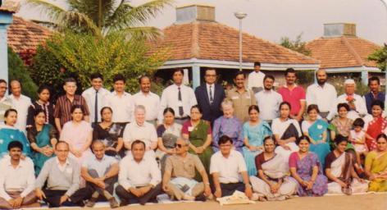
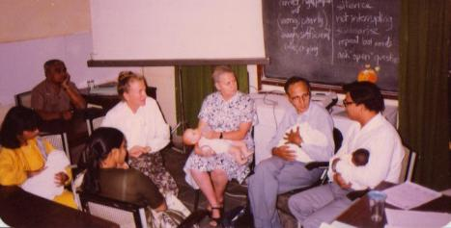
1991: Wardha BPNI was born…
During a training of trainers of human lactation on 3rd Dec,1991

Slide 3
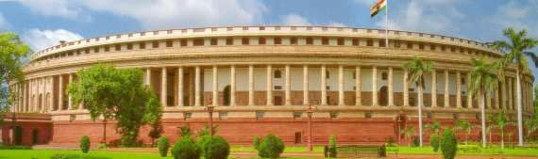




India enacted a Law in 1992
1992:Bill 41 of 1992 was enacted the
“Infant Milk Substitutes, Feeding Bottles and Infant Foods (Regulation of Production, Supply and Distribution) Act, 1992’(IMS Act) .
It came into force on August 1,1993.
All Parties supported it.
2003 : Amendment Act
This reflects lot of work with civil society..

Slide 4
1998-2005
National voice to strengthen the IMS Act began
Many organisations joined hands
2000 Cable TV Law banned promos of baby foods and bottles
2003: Amendment Act enacted to ban promotion of baby foods till 2 years of age.

Slide 5

2004: The Baby Food AD WAR

Slide 6
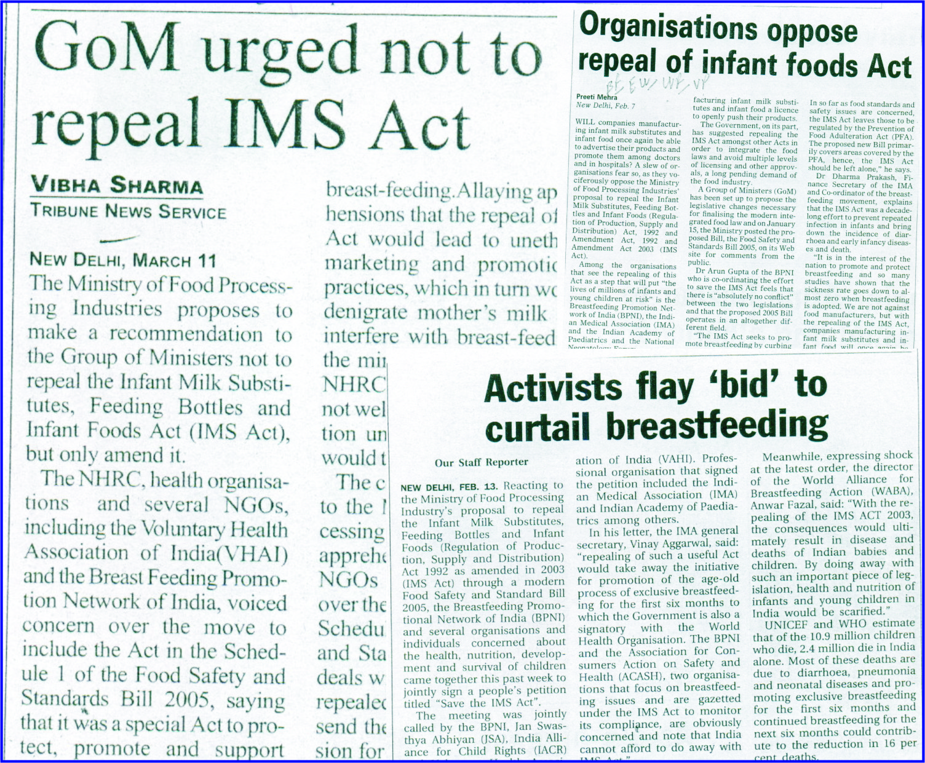
2005 : Save the IMS Act from REPEAL

Slide 7










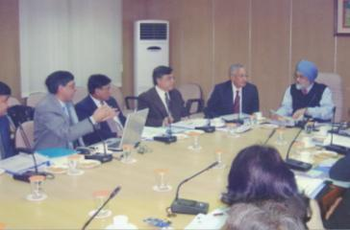



2006: Joint Statement on Infant and Young Child Feeding
Right to Food Campaign

Slide 8
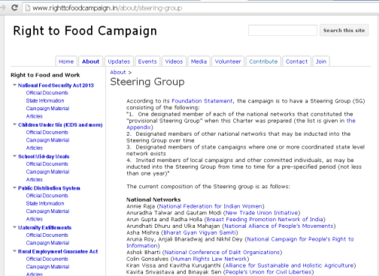

2009: Right Food Campaign Steering Committee Member
National Food Security Act recognises exclusive breastfeeding and provides cash entitlements.

Slide 9




World Breastfeeding Trends Initiative( WBTi)
India Assessment 2005-2015
Working Group Children Under-6
ECCD

Slide 10


Slide 11
Results of advocacy

Slide 12
Entitlements for maternity protection
Benefits for all women under a conditional cash transfer scheme as wage compensation
6 months Paid maternity leave for women in the central government and some State governments

Slide 13
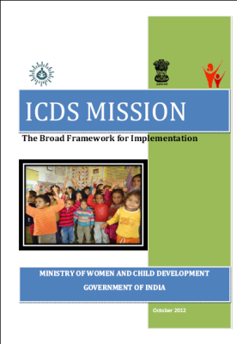
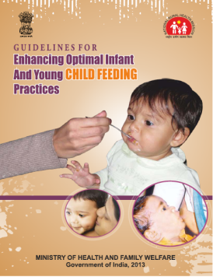
2012:2013 Response of government of India in Health and ICDS

